Slide 1

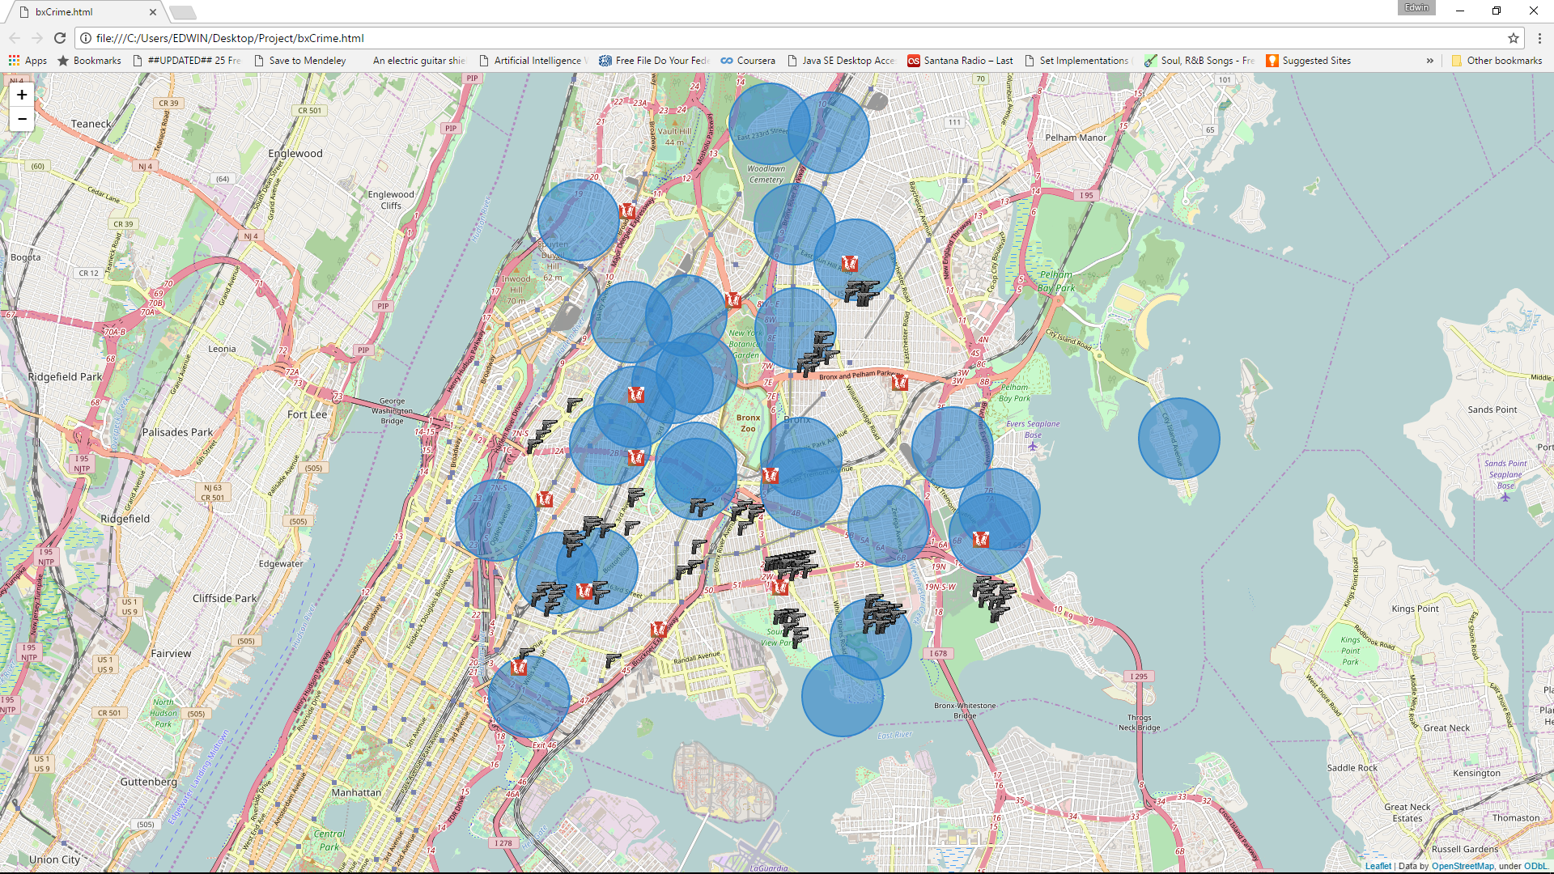
Crime & Housing In The Bronx
This project performs an analysis on a handful of neighborhoods for purchase of a single family home in The Bronx.
The major concerns were felony crime and investment value.
Is there really a correlation between the two?
Is there a correlation between Police Precinct Locations & crime?

Slide 2
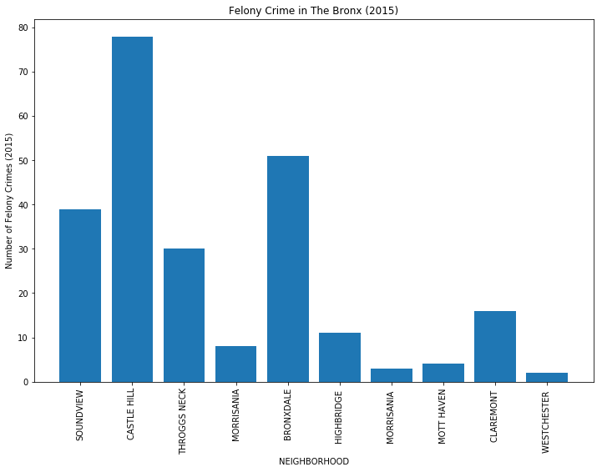
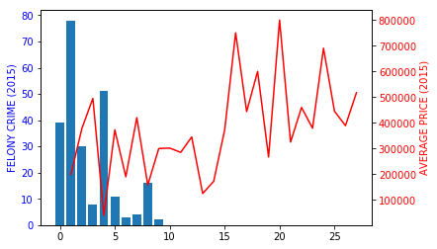
Charts , Analysis and Conclusions
The chart on the left shows the magnitude of crime in the particular neighborhoods requested.
The chart on the right is for making a comparative analysis of crime and costs in those areas .
With the folium map it is quite clear (and surprising) to see that proximity to police precincts doesn’t have the presumed positive effect on crime in the area.

